Slide 1
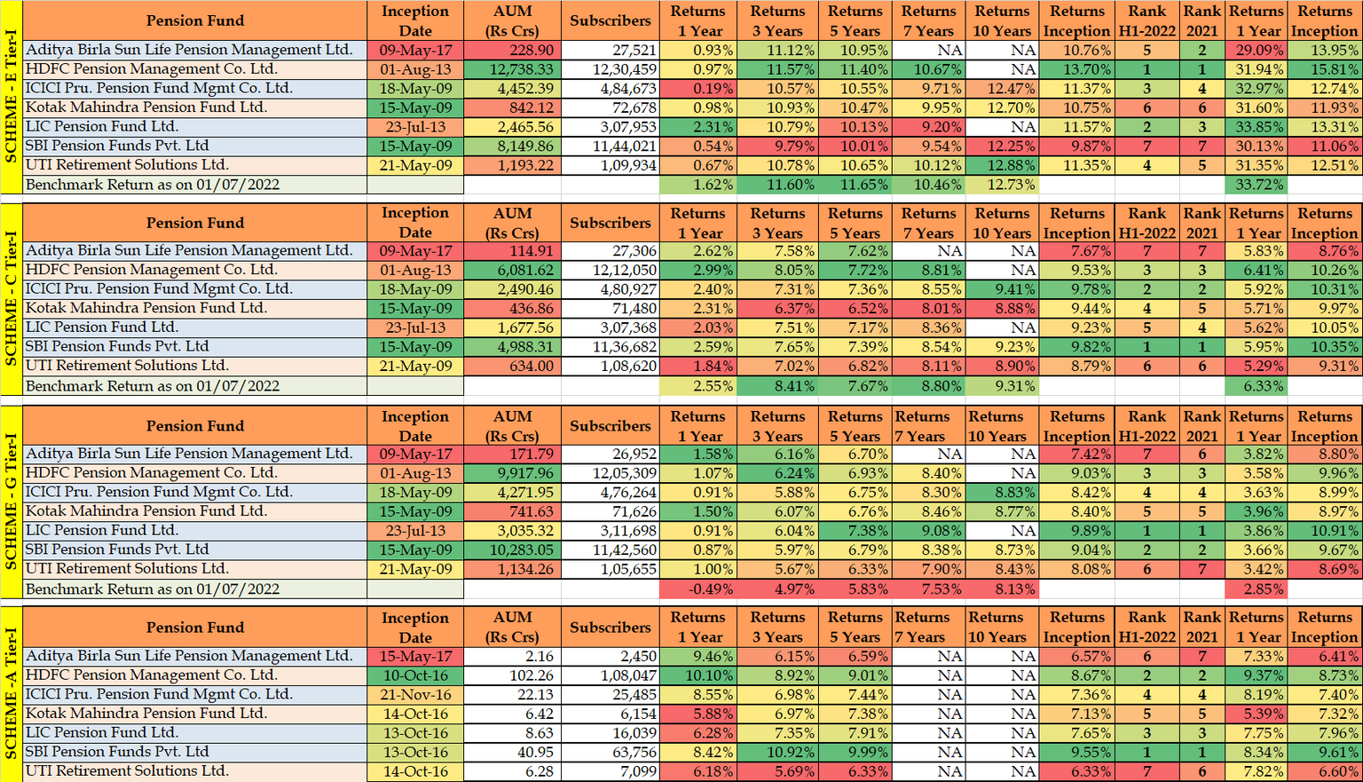
EVERY PAISA MATTERS

Slide 2
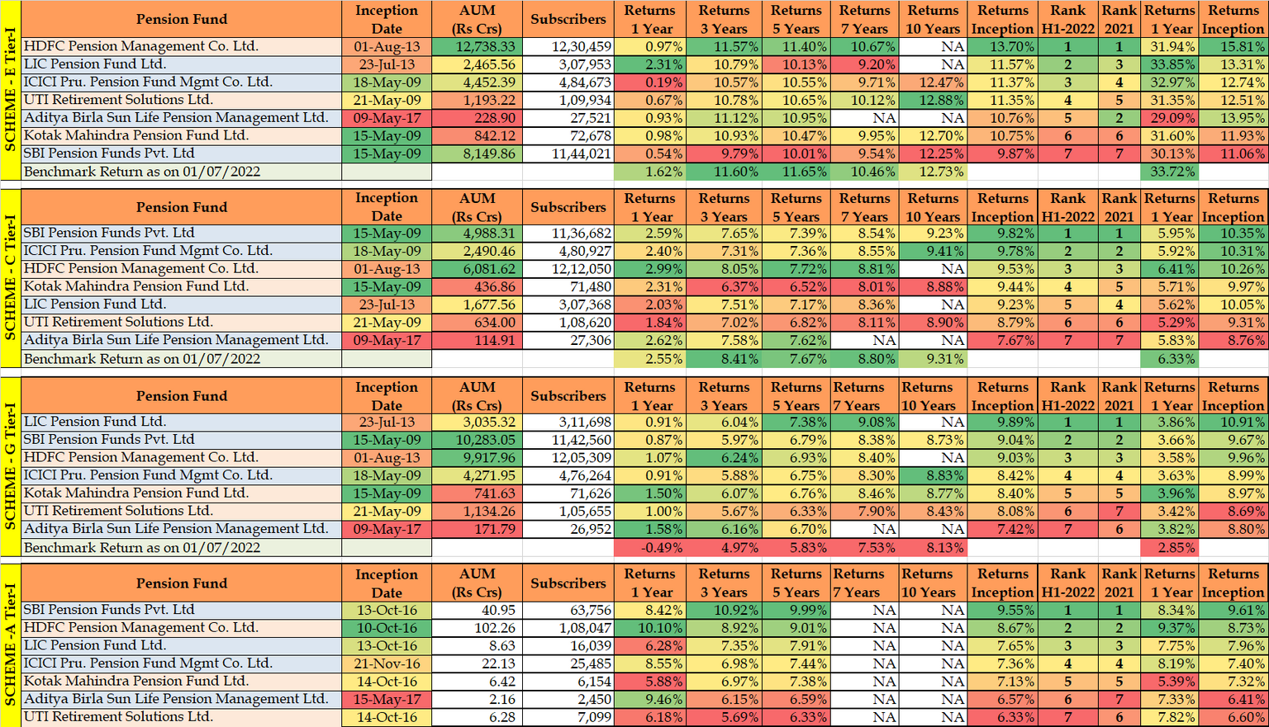
EVERY PAISA MATTERS

Slide 3
EVERY PAISA MATTERS

